Slide 1




Welcome to TeachHub!
This presentation introduces an online platform that supports student learning across subjects with personalized lessons and expert guidance.
Supervised by Eng. Khaled Sedki

Slide 2



Team Members
Group B
Ahmed Al-Jafarawy
Home, Top students, Contact, Blog
Abdulah Yasser
Login, Sign Up, nav
Ibrahim Adel backend
Rana Karim
Reports, About
Salah Khafaji
Profile, Admin Page, UI
Yousef Sayed
UI, Footer, Course

Slide 3
Ahmed Al Jafarawy
Home page, Top Students, Contact and Blog Page

Slide 4


UI & Tech Stack
.
Core Technologies
- React.js frontend
- Firebase / Node.js backend - Tailwind CSS for styling
Performance
Fast load times with seamless navigation between features.
Mobile-Friendly Design
Responsive UI ensures smooth use on any device.

Slide 5
Problem
Difficulty tracking student progress.
Weak interaction between teachers
and students.
Low student engagement and motivation.

Slide 6
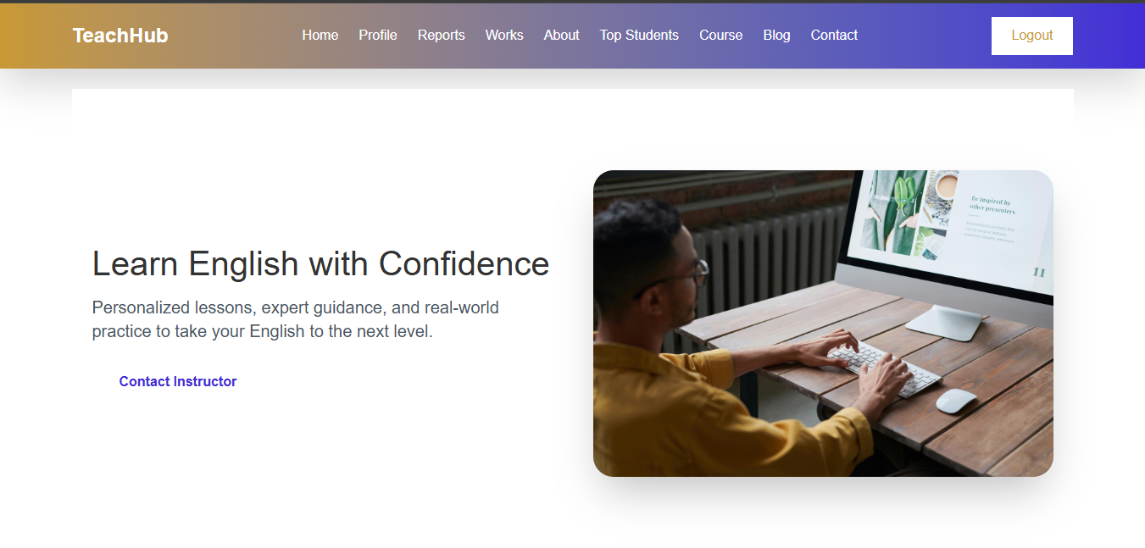
Home page

Slide 7
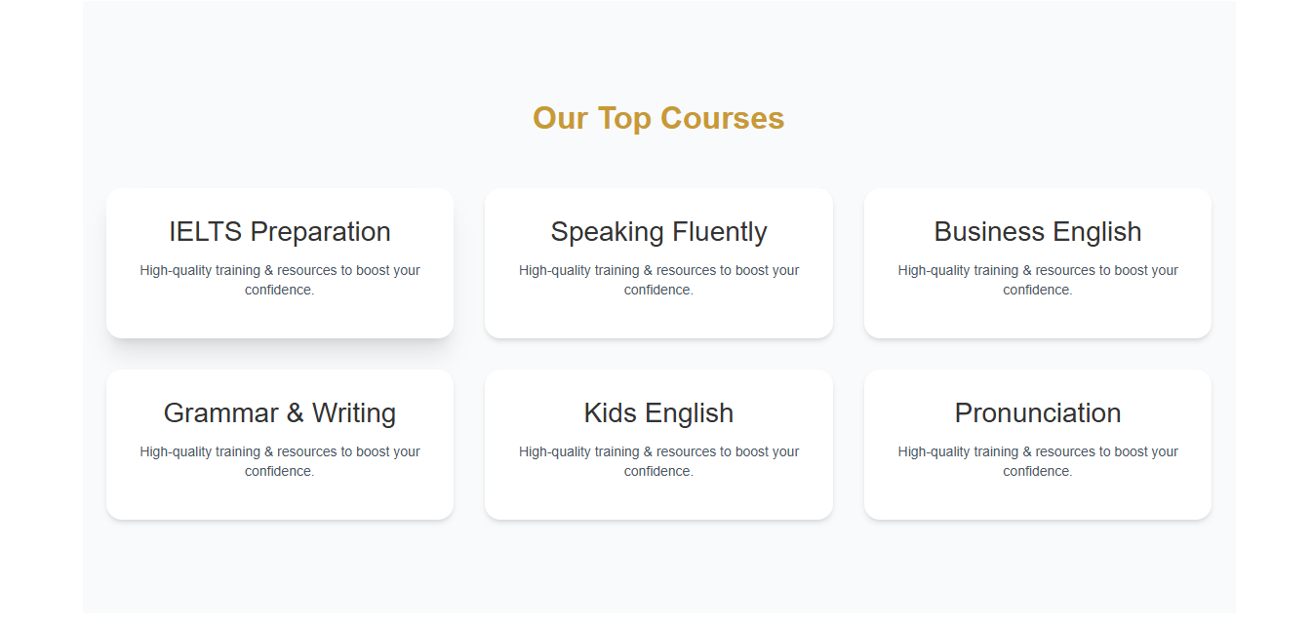

Slide 8

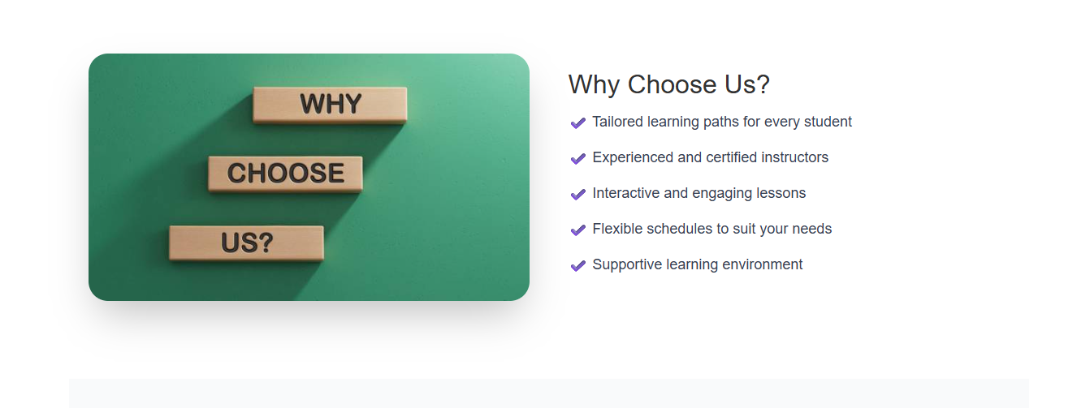

Slide 9
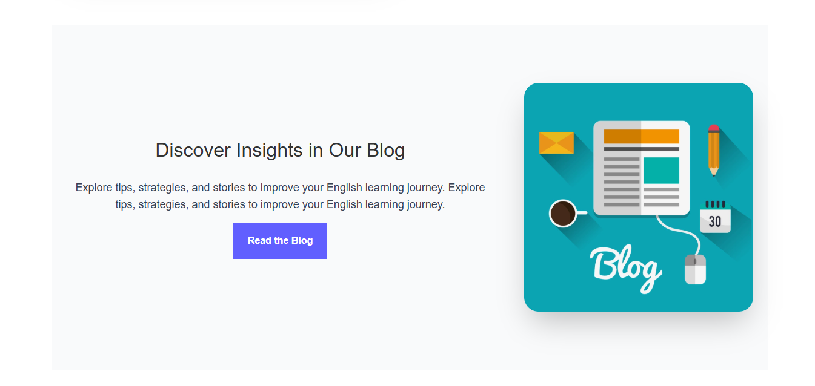

Slide 10

Top Students Page
To highlight and reward high-performing
students.
To showcase success stories and drive traffic.
To foster a competitive and engaging learning environment.

Slide 11
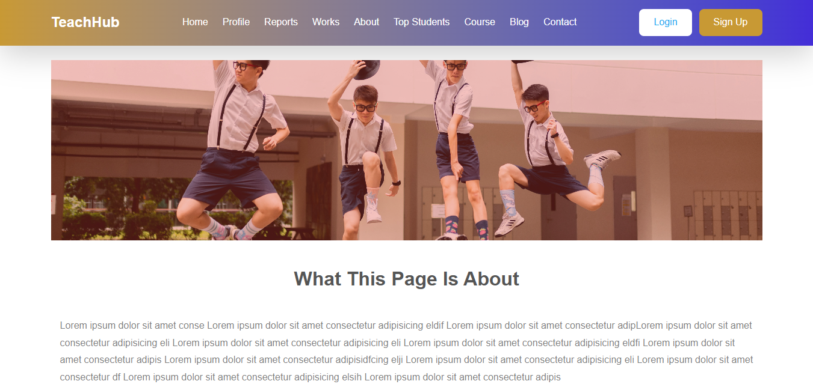

Slide 12
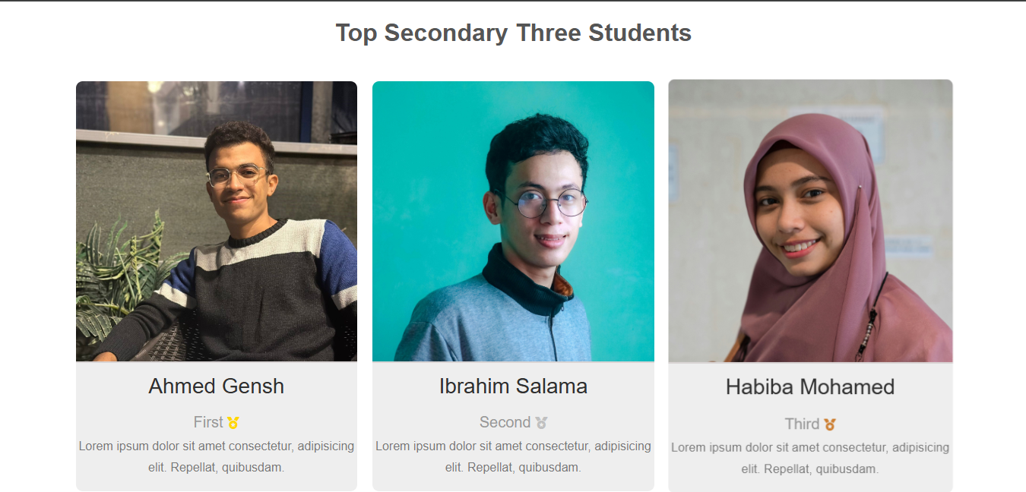

Slide 13
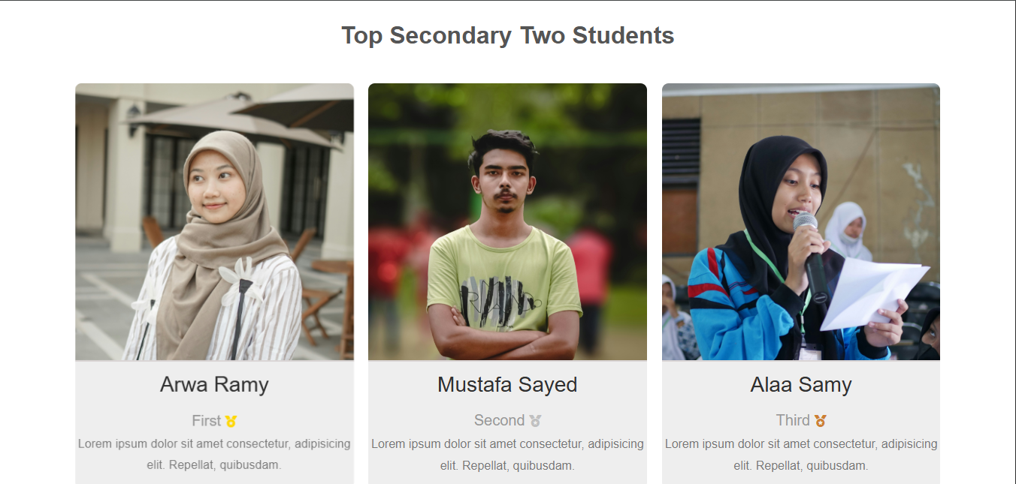

Slide 14
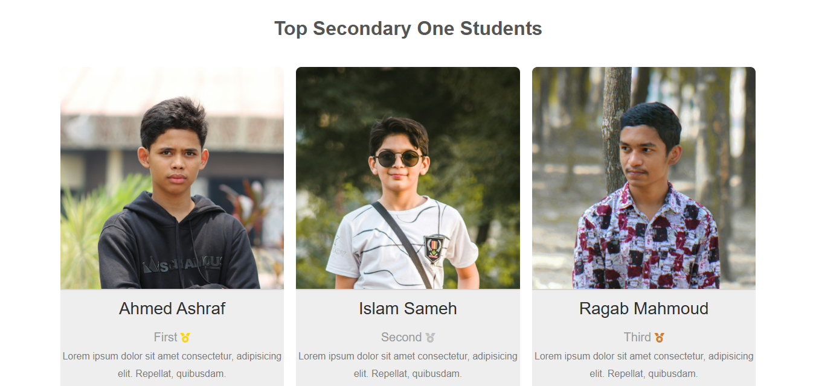

Slide 15


Contact Page
Contact Page:
This section provides students and parents with clear and direct ways to contact the platform, join community groups, and stay updated through social media. It helps build strong communication and support between the platform and its users.
Address
Email
Website
Social Media
Facebook Groups
WhatsApp Numbers
Contact Form

Slide 16
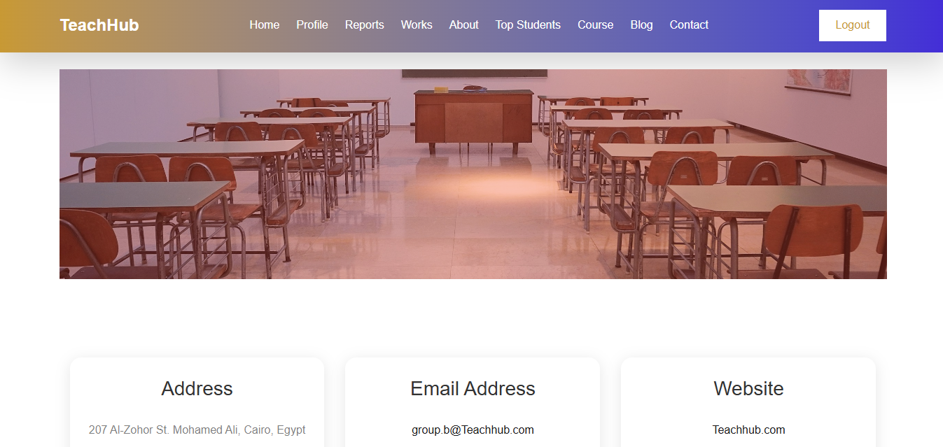

Slide 17
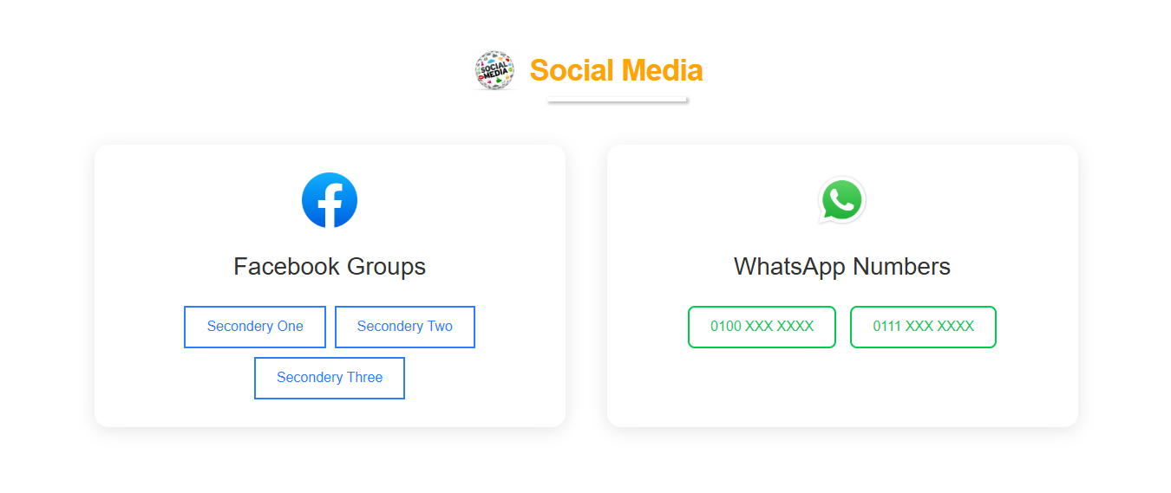

Slide 18
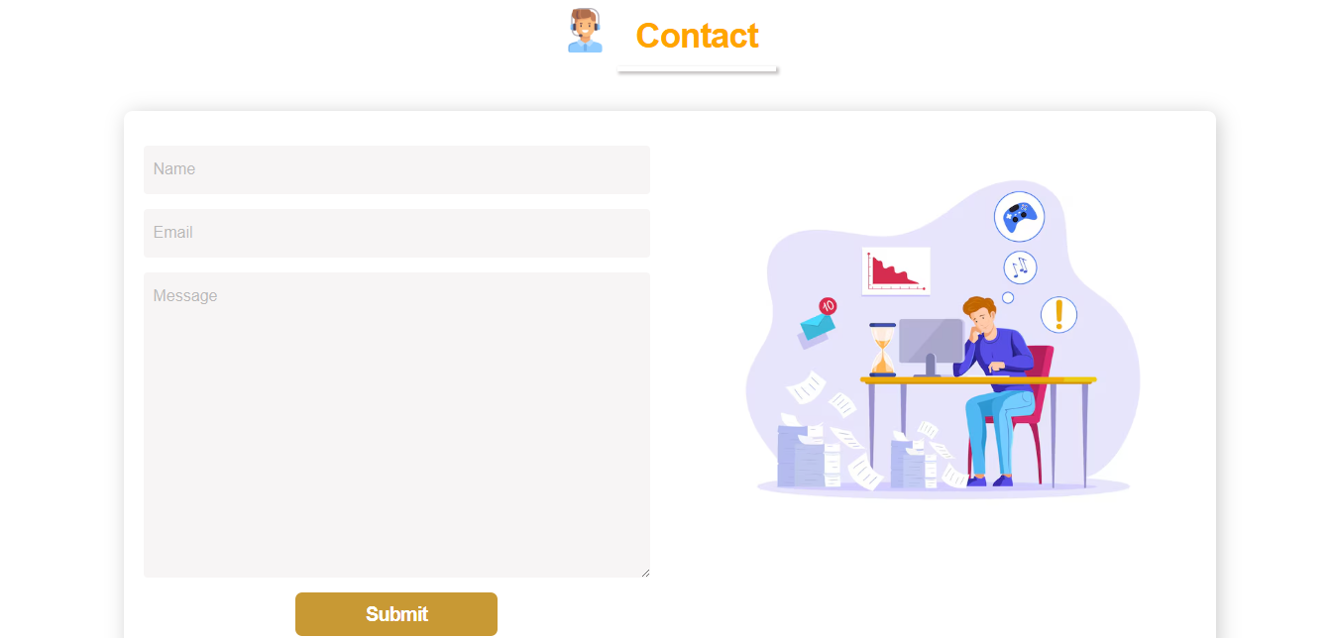

Slide 19

Blog Page
The blog page provides educational articles to support students with tips, explanations, and learning strategies.
Blog
Page
The blog shares useful educational content, recommended resources, and external links suggested by teachers for students.

Slide 20
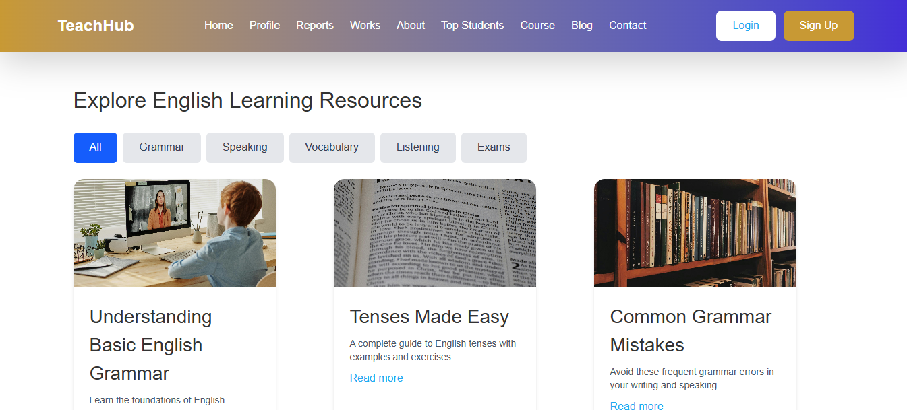
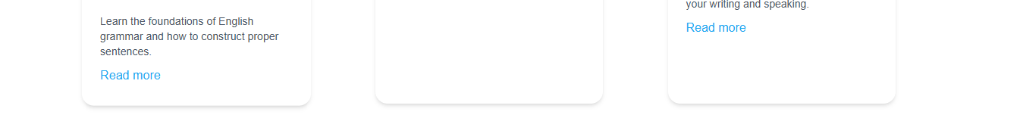

Slide 21
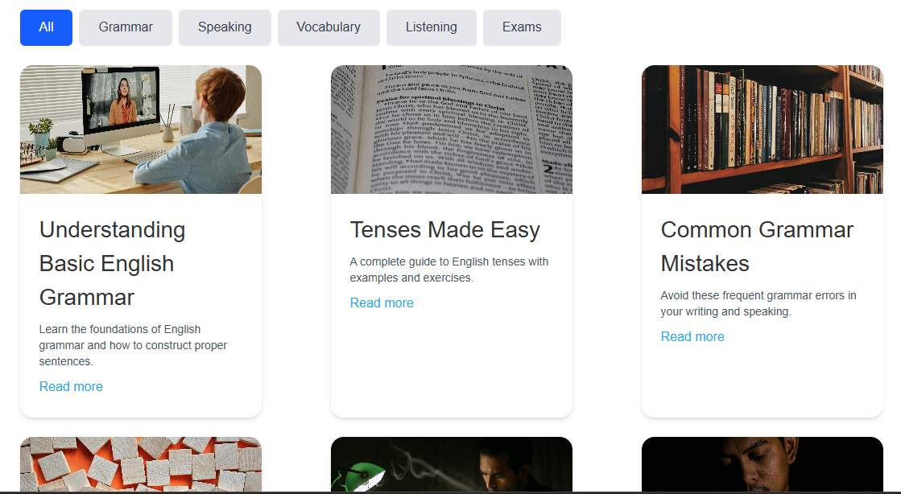

Slide 22
Adullah Yasser
Login Page, Signup Page, Nav and work Page

Slide 24
Monthly Assignments Page
Displays student assignments organized by month.
Helps manage and submit homework on time.
Currently static, but will be connected to the backend soon like other pages.

Slide 25
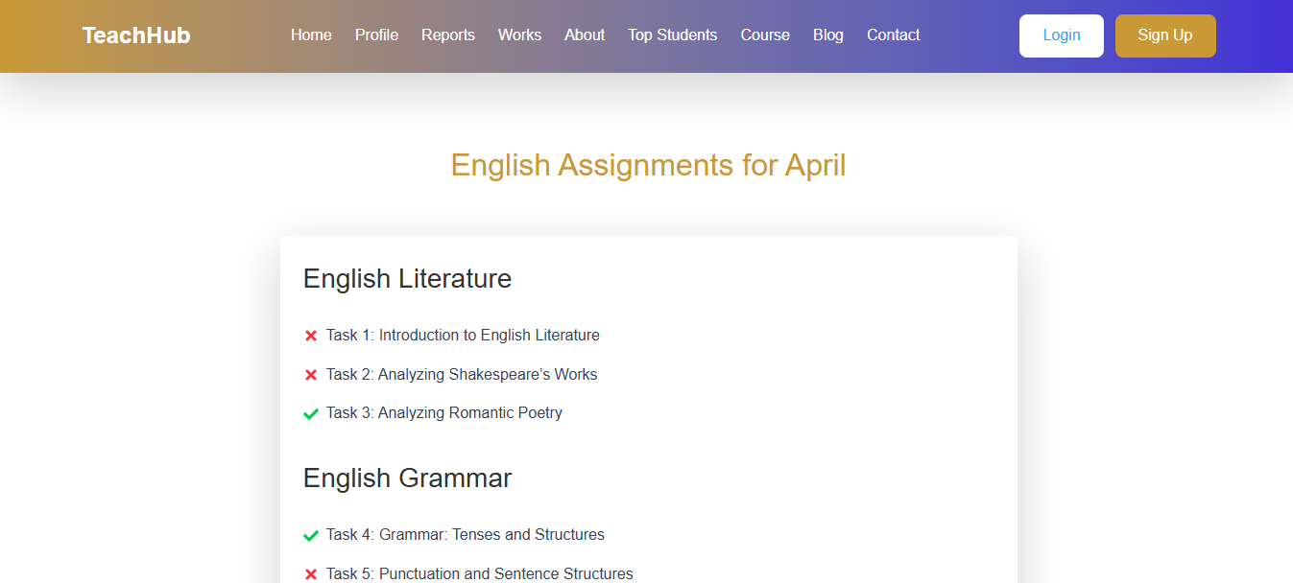
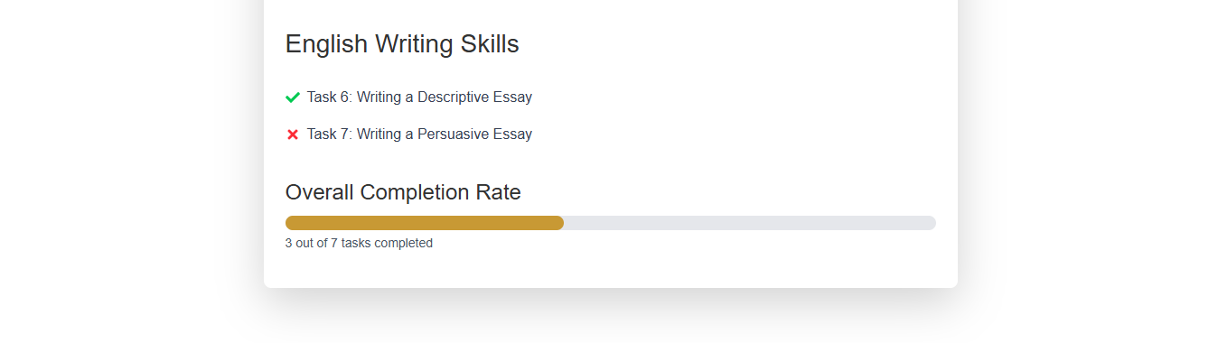

Slide 26
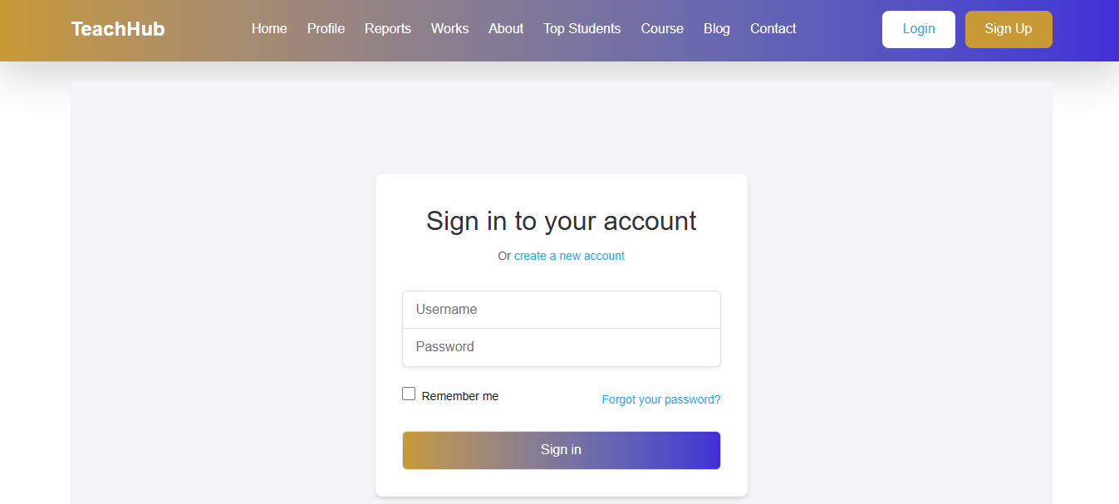

Slide 27
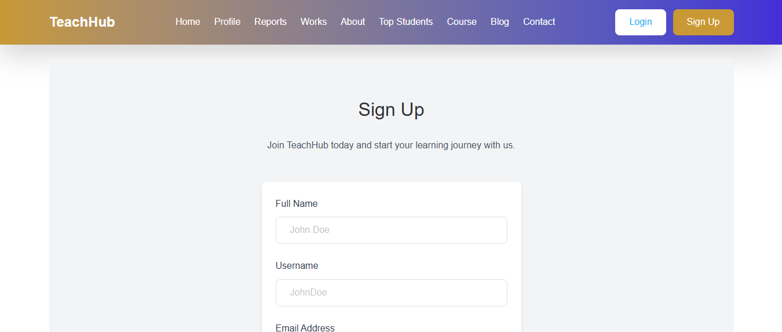


Slide 28
Ibrahim Adel
Backend

Slide 29

Backend Tech Overview
✅ Built with Node.js and Express.js for handling server logic and APIs.
🔐 Implemented Authentication & Authorization to secure user access.
☁️ Image uploads are handled via Cloud storage (e.g., Cloudinary or similar).
📄 Full CRUD operations implemented for managing data (Create, Read, Update, Delete).
🛢️ Used MongoDB as our database to store user and course data efficiently.

Slide 30
Rana Kareem
Reports, About

Slide 31
Reports Page
Robots Page
Shows number of exams taken.
Displays correct and incorrect answers.
Helps students track their progress and performance.

Slide 32
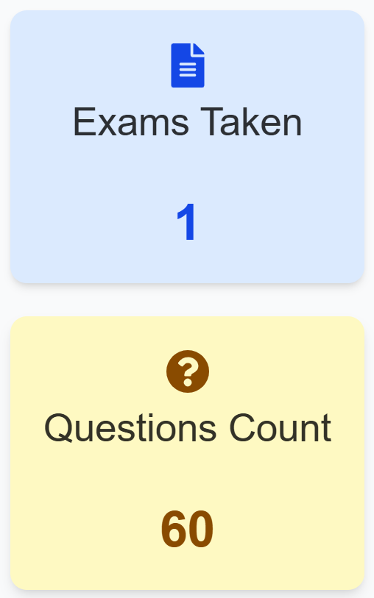
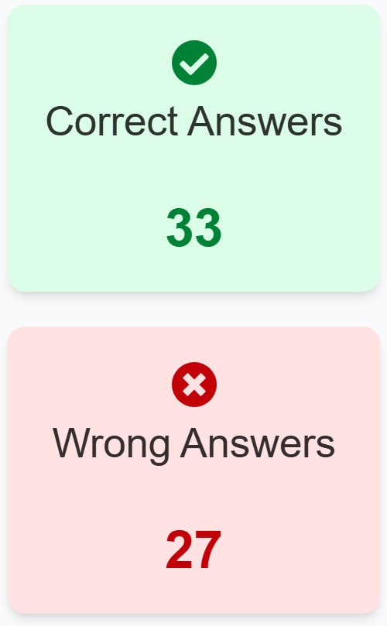
Quizzes & Grading
1 2
Quiz Creation
Supports MCQs, true/false, and other question types easily.
Grading Systems
Automated or manual grading options for teacher flexibility.
3 Real-Time Grades
Students access grades instantly through their dashboards.

Slide 33
About Page
About the Teacher PageShows teacher's name, bio, and photo.
-Highlights teaching experience and subject specialization.
- Builds trust between students and teacher.

Slide 34
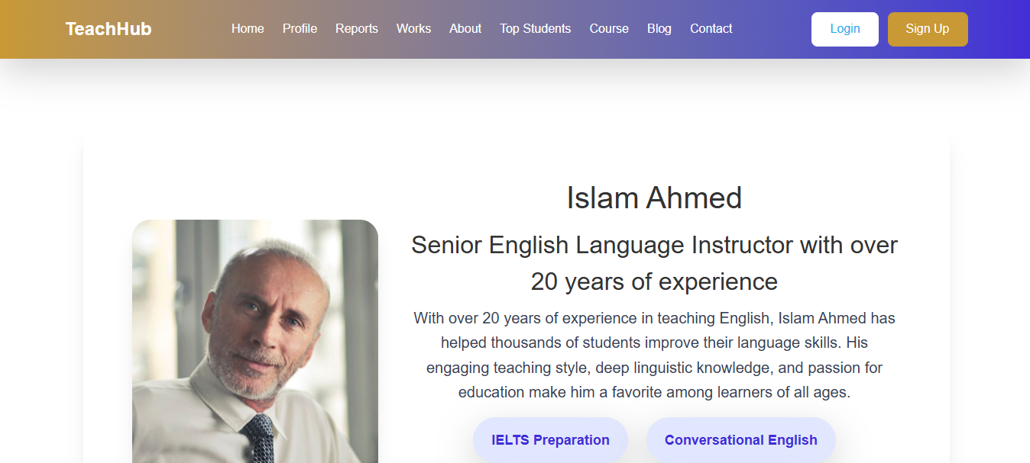
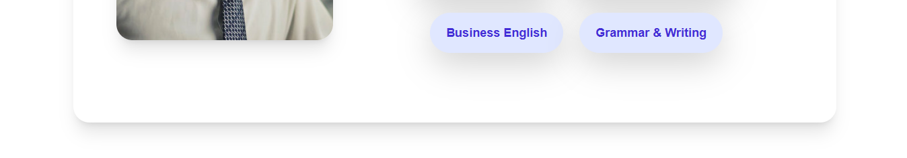

Slide 35
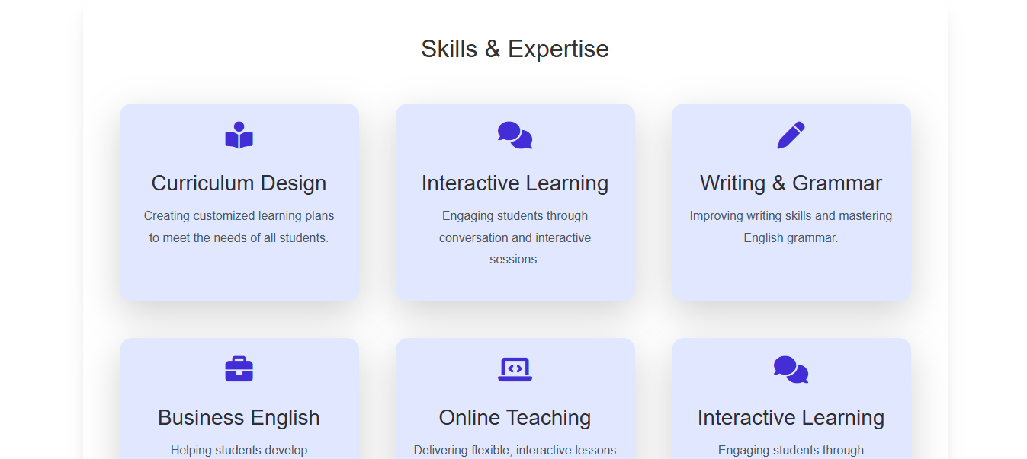
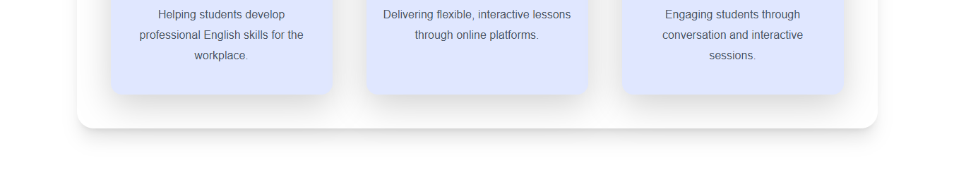

Slide 36
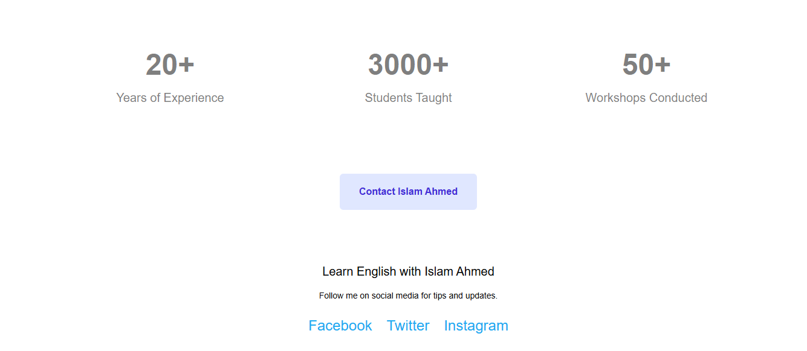

Slide 37
Salah Khafaga
UI, Profile Page, admin Page

Slide 38


Slide 39
Profile Page
Displays user's personal information (name, photo, etc.).
It didn’t Allow users to update their details and preferences.
It have a button Only displays to admins

Slide 40
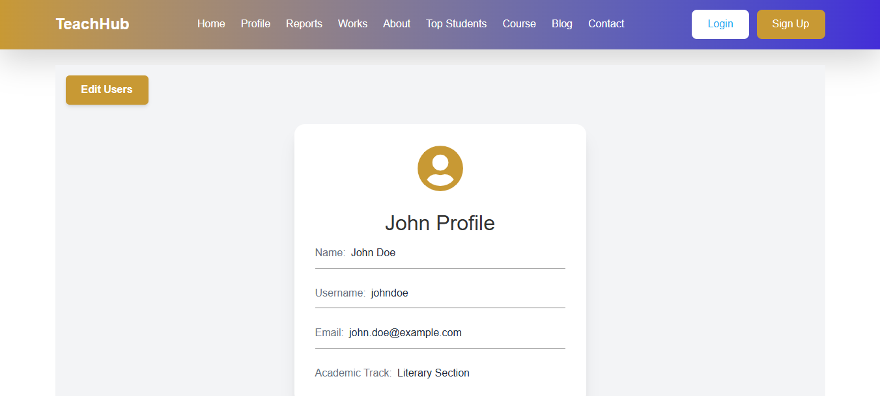

Slide 41

Admin Page
Visible only to admins for managing user data.
Allows admins to control user grades and progress.
Enables viewing and editing of user profiles.
Provides tools for managing courses and assignments.

Slide 42
Visible only to admins for managing user data.
Allows admins to control user grades and progress.
Enables viewing and editing of user profiles.
Provides tools for managing courses and assignments.

Slide 43
Yousef Sayed
UI, Course Page, Footer

Slide 45
Course Page
Divided into Units, each containing related lessons and videos.
Provides course details like topics, duration, and instructor.
Helps students easily navigate through the content.

Slide 46
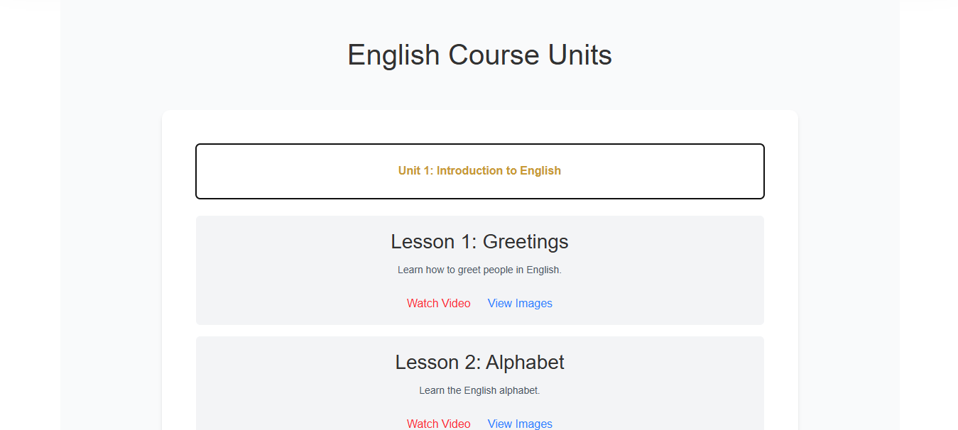
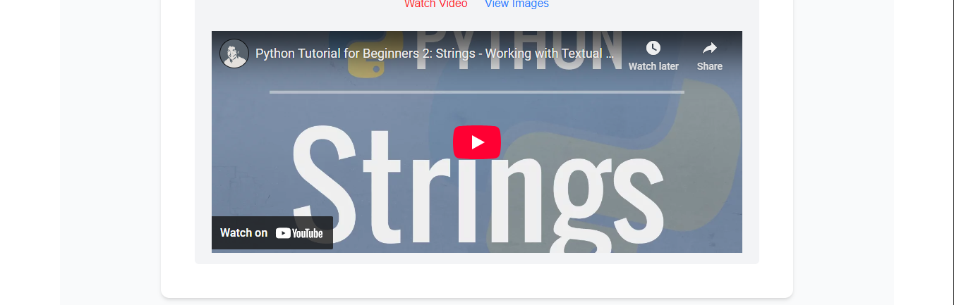

Slide 47
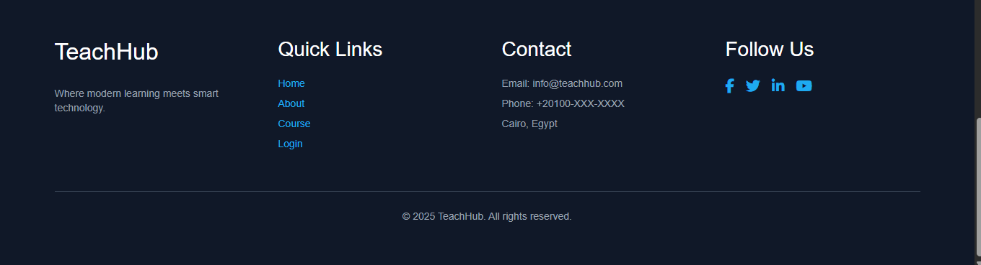
Footer

Slide 48

Thank You!

